Slide 1

SDM COLLEGE OF ENGINEERING AND TECHNOLOGY, Dharwad-580002
(An autonomous Institution affiliated to Visvesvaraya Technological University, Belagavi – 590018)
Project entitled by
“SENSE AMPLIFIER FOR MEMORY READ AND WRITE”
TEAM PROJECT BY
Anusha V Hiremath Diksha F Bevinakatti Gadigemma M Neelagund Keerti M Guddadavar
- 2SD22EC012
- 2SD22EC021
- 2SD22EC022
- 2SD22EC028
Under the guidance of Dr. S. V. Viraktamath Department of E&CE.

Slide 2
CONTENTS
Introduction
Motivation
Objectives
Literature survey
Results
Conclusion

Slide 3
INTRODUCTION
Sense Amplifier is a circuit that amplifies small voltage differences.
Vital for reliable and fast data retrieval in memory systems.
Found in SRAM, DRAM, and Flash memory.

Slide 4
MOTIVATION
Speed Enhancement: Improves read/write access time by quickly sensing small voltage differences in memory cells.
Power Efficiency: Reduces power consumption during memory operations by minimizing active components and operation time.
Scalability: Essential for high-density memories (SRAM, DRAM, Flash) as technology nodes shrink and bit lines become noisier.
Versatility: Crucial for supporting various memory architectures and applications like cache, embedded systems, and mobile devices.

Slide 5
OBJECTIVES
Design and implement a sense amplifier for memory read and write using Cadence Tool.
Analyze the circuit characteristics and performance.
Design an efficient sense amplifier to accurately detect and amplify small voltage differences during memory read operations.
Ensure high speed and low power performance for fast and energy-efficient memory access.

Slide 6
LITERATURE SURVEY
This paper compares different CMOS sense amplifiers based on delay and power performance hybrid mode sense amplifier is found to be the most efficient for high-speed, low-power memory operations.
Sense amplifiers play a critical role in SRAM performance, influencing both speed and power efficiency.

Slide 7
SIGNIFICANCE OF USING SENSE AMPLIFIER
Fast Read Operations: Enable quick data retrieval by amplifying small voltage differences on bit lines.
Low Power Consumption: Minimize power usage by reducing bit line charging/discharging.
Enhanced Sensitivity: Detect small voltage changes for accurate data sensing.

Slide 8
SIGNIFICANCE OF USING SENSE AMPLIFIER
Data Integrity: Ensure reliable data access, especially in low-voltage designs.
Supports Memory Scaling: Essential for high-density, low-voltage memory designs.
6Write Assist: Some designs use sense amplifiers to assist in reliable write operations.

Slide 9
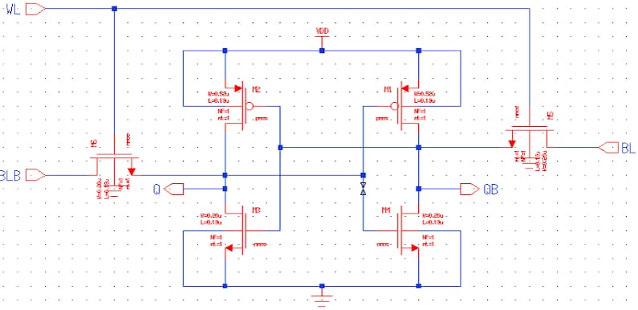
6T SRAM
Fig 1: 6T SRAM CELL

Slide 10
6T SRAM
This is a 6T SRAM cell schematic widely used in memory design.
It consists of two cross-coupled inverters (M3-M5 and M4-M6) forming a latch.
M1 and M2 are access transistors controlled by the word line (WL).
Bit lines (BL and BLB) are used for reading and writing data into the cell.

Slide 11
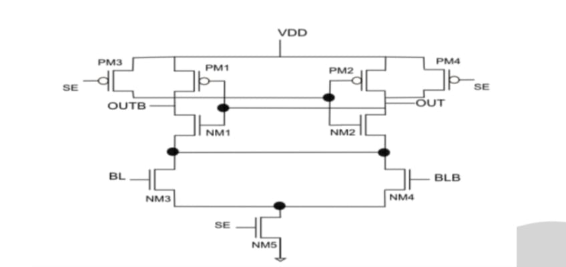
LATCH TYPE SRAM
Fig 2: Latch type sense amplifier

Slide 12
LATCH TYPE SRAM
Cross-coupled NM1 and NM2 form a latch to amplify bit line differences.
PM3 and PM4 pre charge OUT and OUTB when SE is low.
NM5 acts as a current source enabling sensing when SE is high.
Latch-type SRAM stores data using latches for faster, low-power access.

Slide 13
READ OPERATION
Type: This is a differential sense amplifier circuit for SRAM.
Function: It amplifies small voltage differences between BL and BLB lines.
Structure: It has cross-coupled inverters and SE-controlled PMOS/NMOS switches.
Operation: Activating SE triggers fast sensing and full-swing output generation.

Slide 14
RESULTS
Based on Figures 1, 2, and 3, the proposed design was successfully implemented and simulated using the Cadence tool.
Figure 4:Illustrates the schematic of the latch-based SRAM cell.
Figure 5:Presents the transient response, confirming proper functionality and stability.
Figure 6:Shows the Pre charge waveforms, validating accurate memory operations.
The simulation results demonstrate reliable performance aligned with the design objectives.

Slide 15
DIFFERENT TOPOLOGIES OF SRAM
The different topologies of SRAM, 6T, 7T and 8T are constructed in order to compare the performance analysis.
The schematics of the various SRAM topologies (6T, 7T and 8T) that are simulated by the Cadence Virtuoso tool.

Slide 16
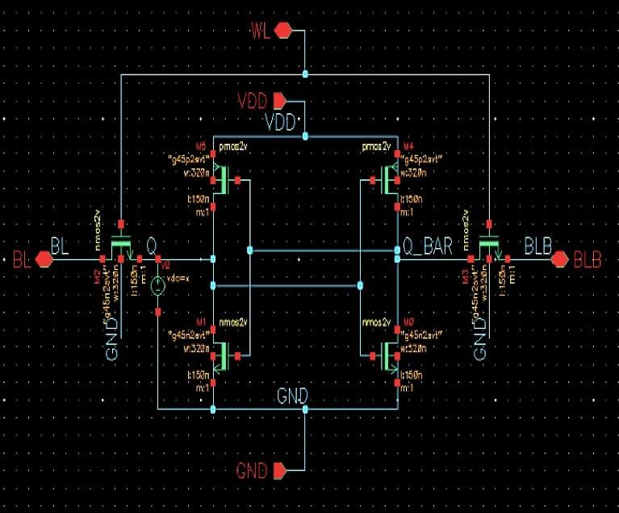
6T SRAM
Fig 4: 6T SRAM CELL

Slide 17
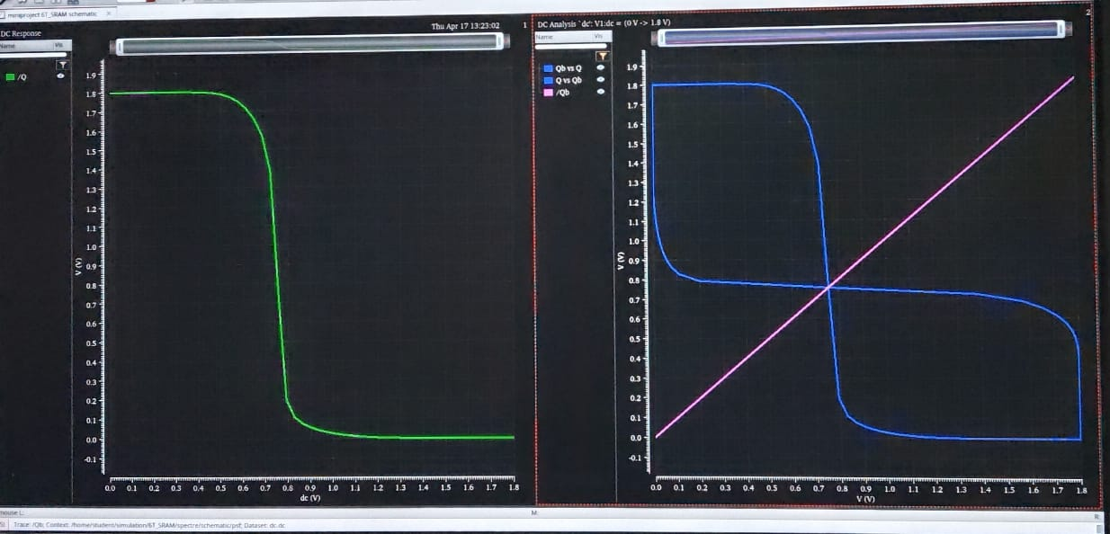
Output of SRAM

Slide 18
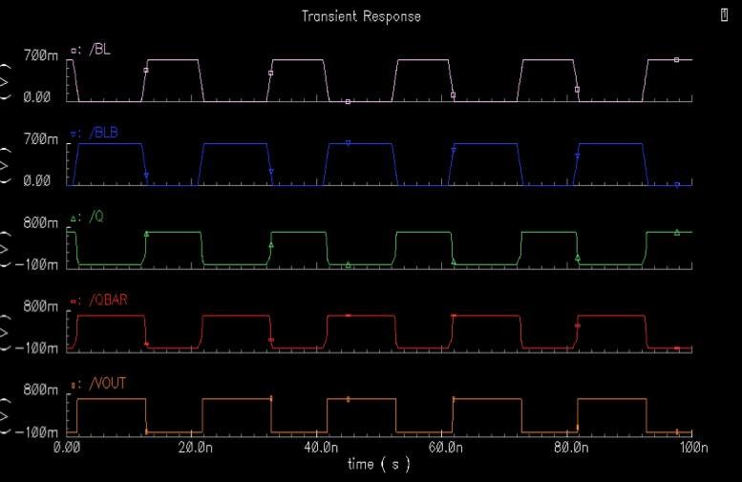
Read operation of 6T SRAM

Slide 19
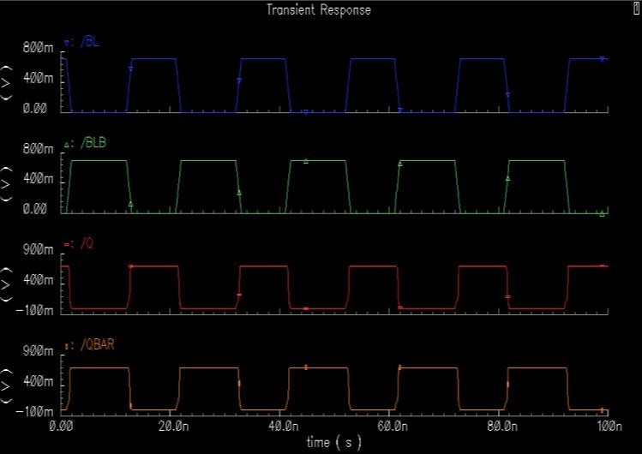
Write operation of 6T SRAM

Slide 20
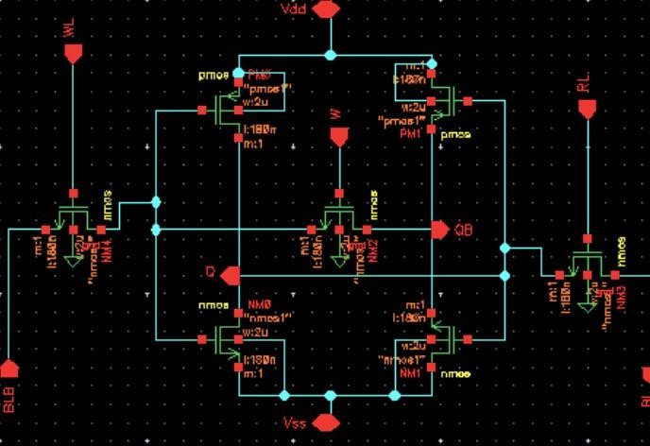
7T SRAM

Slide 21
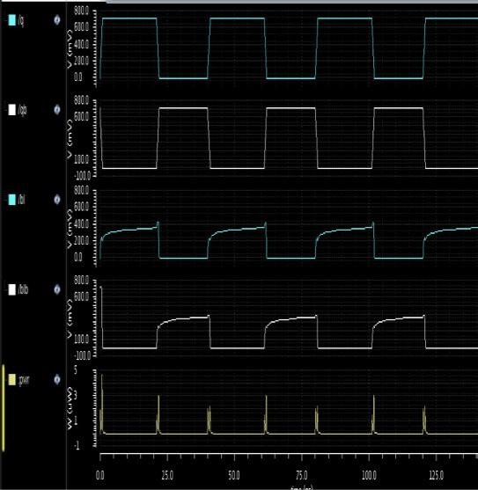
Read operation of 7T SRAM

Slide 22
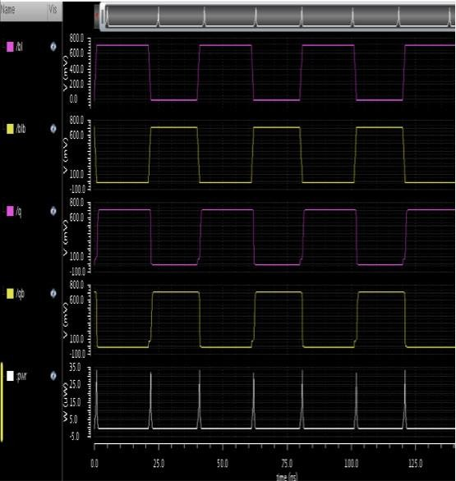
Write operation of 7T SRAM

Slide 23
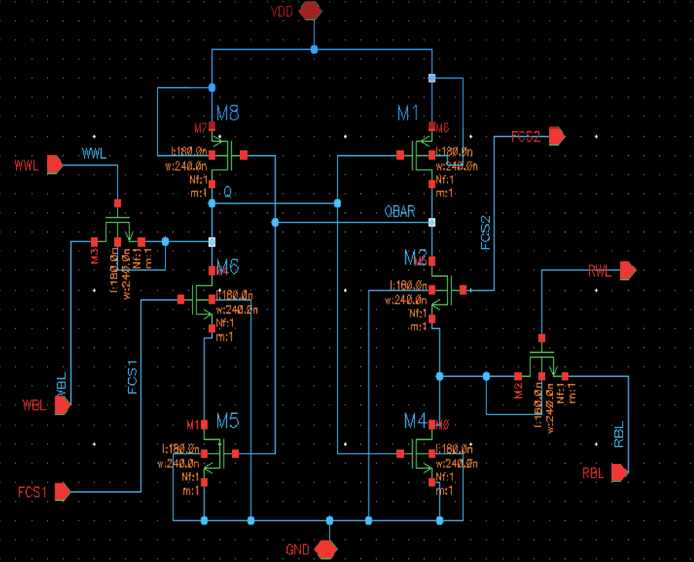
8T SRAM

Slide 24
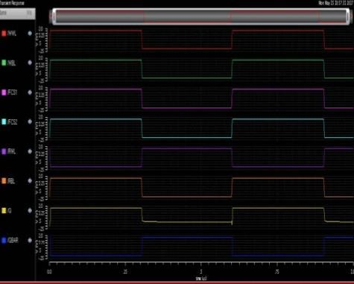
Read operation of 8T SRAM

Slide 25
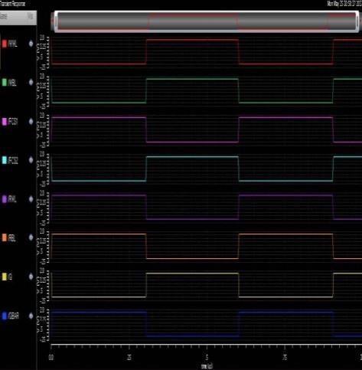
Write operation of 8T SRAM

Slide 26
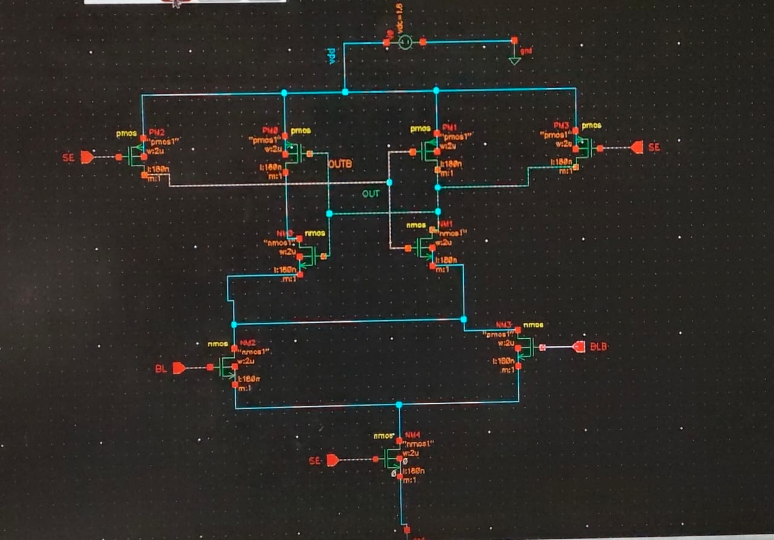
Latch Type SRAM
Fig 5: Latch type sense amplifier

Slide 27
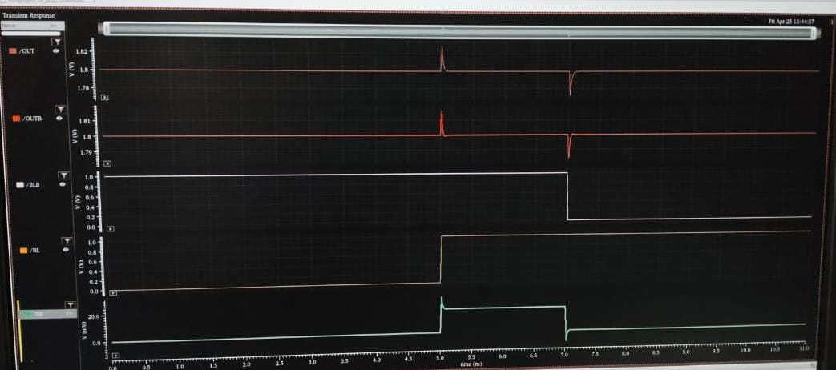
Output of Latch type SRAM

Slide 28
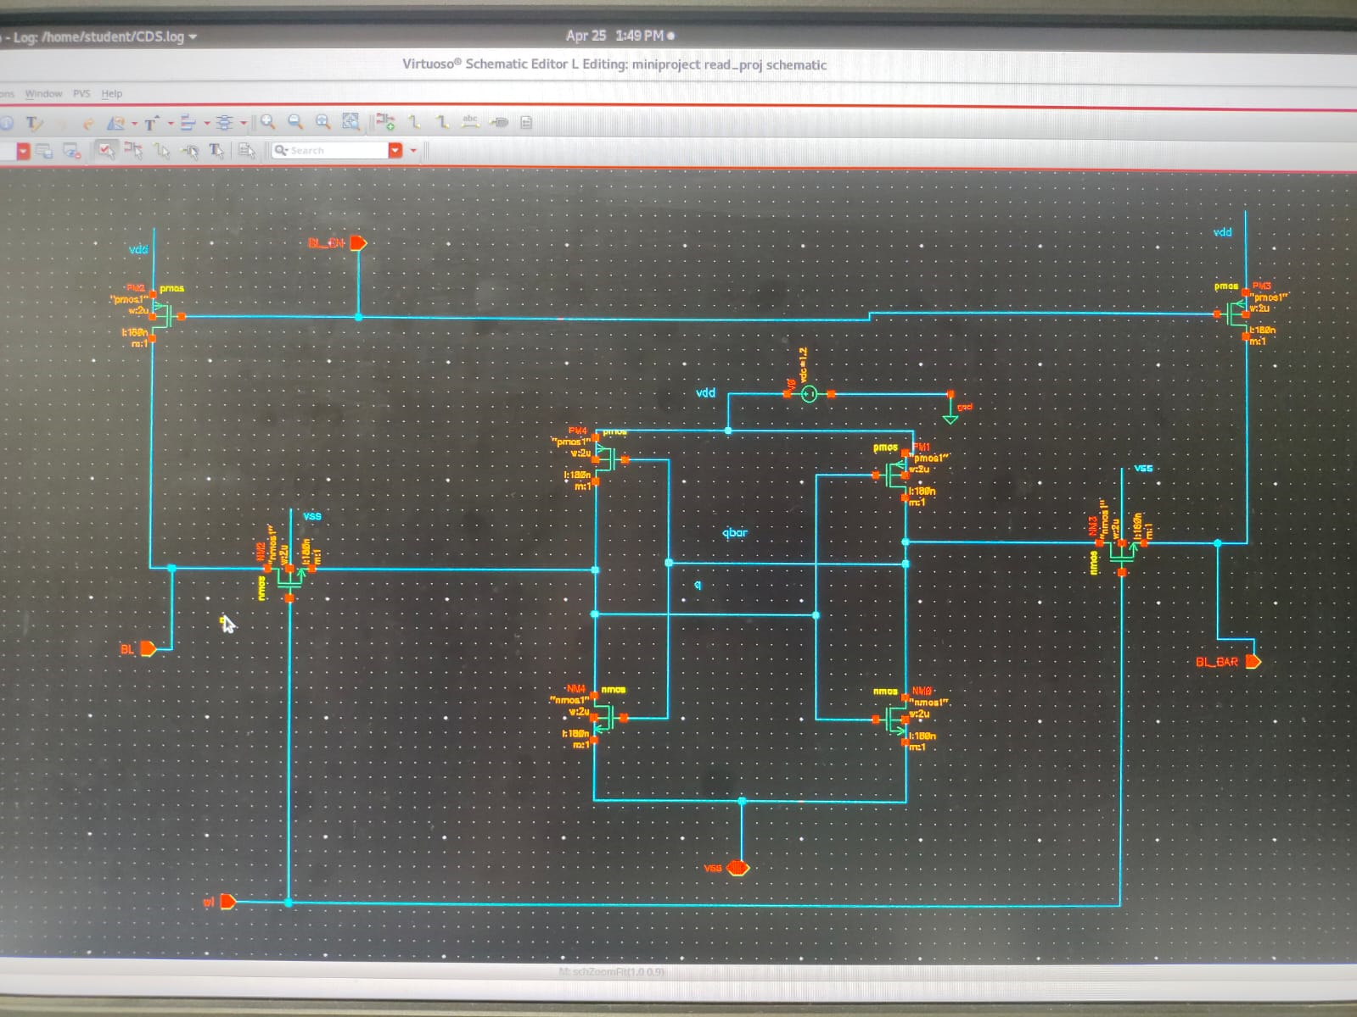
Pre-Charge circuit
Fig 6: Pre-Charge circuit

Slide 29
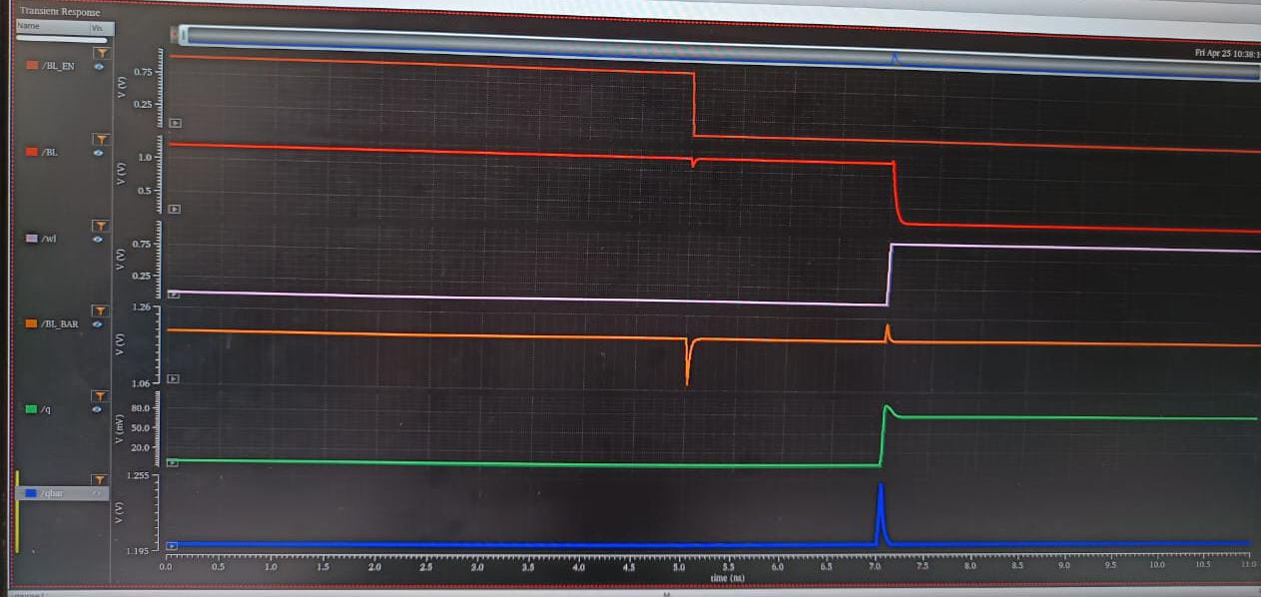
Pre-charge

Slide 30
CONCLUSION
The sense amplifier boosts small voltage differences for fast and accurate memory reads.
It enhances speed, stability, and energy efficiency during read and write operations. Overall, it is vital for improving the performance and reliability of memory systems.

Slide 31
Progress
Designed and simulated a Sense Amplifier in Cadence Virtuoso.
Verified functionality through DC and transient analysis.
Planning variability checks using corner and Monte Carlo simulations.
Layout, DRC/LVS, and performance comparison with existing designs are upcoming.

Slide 32
REFERENCES
G. Poshmallu ,R. Radha, J. Manasa, R. Pruthvi, “Estimation Of Delay And Power Analysis Of Sense Amplifiers ” Publish year-2020
Vyshna P, Dr. Jinsa Kuruvilla, “Design Of Sense Amplifier For SRAM With Low Consumption And High Stability” Publish year-June 2019

Slide 33
THANK YOU

